Slide 1
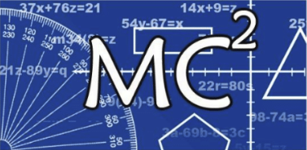
Mathematically Connected Communities
This session will be recorded and available at https://mc2.nmsu.edu/
Welcome! Please introduce yourself in the chat box by writing your name, your district, and your role in the education sector.
Purposeful Reentry and Adapting to Change
August 12, 2020
5:00-6:10 pm
Handout for Session: https://docs.google.com/document/d/1jNxbsexfpsToDDiwMDHyttGxQ8AKxIktMacGdyMxs9I/edit?usp=sharing

Slide 2
Mathematically Connected Communities
Purposeful Reentry and Adapting to Change
August 12, 2020
5:00-6:10 pm

Slide 3
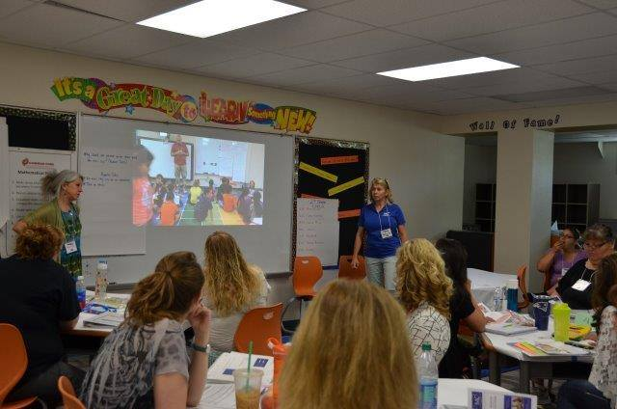
About MC²
Mathematically Connected Communities (MC² ) is:
A partnership of dedicated math educators, including teachers, mathematicians, researchers, and school district administrators, working collectively to improve mathematics learning for K-12 students across the state of New Mexico
Initiated with funding by the US Department of Education/ Math-Science Partnership (MSP), the NM Public Education and Higher Education Departments (PED and HED), and Title II funding by districts to strengthen the quality & effectiveness of teachers, principal, and other school leaders

Slide 4
Mathematically Connected Communities (MC2) works to improve math education through a variety of professional learning experiences which align to NM PED’s reentry guidance.
Four Live Web-Events Sessions
Awareness and Information: Purposeful Reentry and Adapting to Change
Unpacking Important Mathematics Reentry Documents
Structuring Accelerated Learning in Reentry
The Importance of Models in Developing Fluency

Slide 5
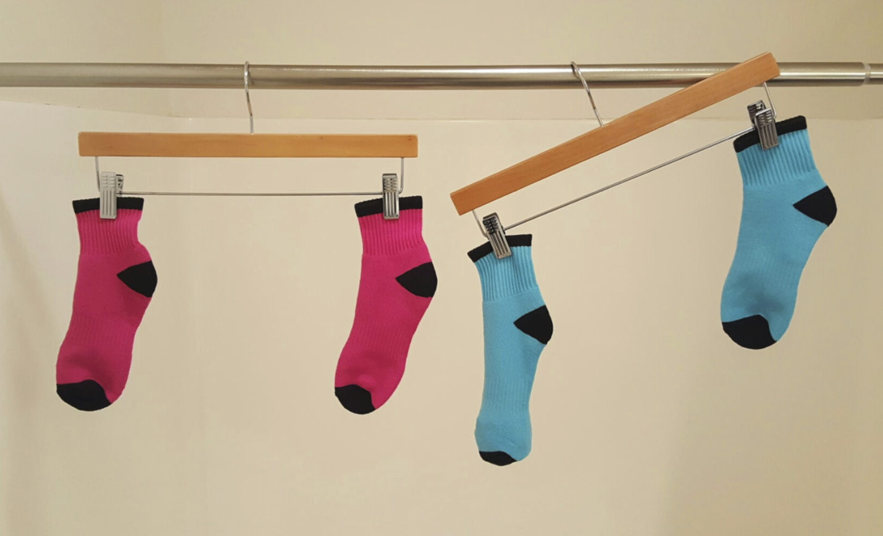

Slide 6
Zoom Poll results!

Slide 7
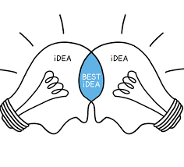
Norms for Break Out Rooms
We will have 10 minutes in break out rooms to think, share and discuss. In exploring today, what are the norm(s) you will take with you?
Invite participation by using names
Honor individual thinking and learning time
Ask questions
Expect to share
Reflect on where you want to grow

Slide 8
Purposeful Reentry: Know and Grow
What aligns with what I already know?
Where do I want to grow?
In the Overview document of each of the grade/course Instructional Scope document is a section on Culturally and Linguistically Responsive Instruction.
Read through this section and reflect with your break out room on the following:

Slide 9
Standards Based Learning Environment
Ice Breaker/Team Builder
Mindset
Norms
Do Rich Math
Refection
Supports: Positive Mindset, challenges absolutes, praises processes over ability, discourse
Supports: Communication, reasoning, retention, synthesis, assessment and evidence of understanding, written discourse
Supports: Mathematical identity, confidence, supportive learning environment, discourse, resiliency, positive mindset
Supports: Classroom culture, equitable participation, engagement, establishment of a positive classroom climate, discourse
Supports: Assessability, multiple approaches, multiple representations, collaboration, discourse, engagement, curiosity, and creativity
1
2
3
4
5

Slide 10
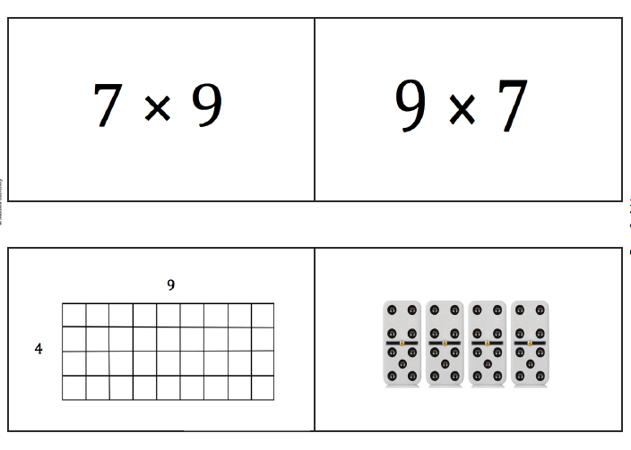
Math Cards
Introduce yourself to your breakout room.
Have one participant connect with Desmos and share screen so that you can work collaboratively in your break out room.
Be mindful of the norms established.
Be ready to share out!
DESMOS LINK TO ACTIVITY: https://student.desmos.com/join/fp8tab

Slide 11
What was engaging for you? (and how do we replicate that with our kids?)
What is the important mathematics students are engaging in with this?

Slide 12
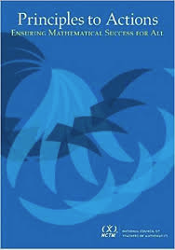
SBLE and Purposeful Reentry
Reentry Plans
SBLE
Culturally Responsive
Instructional Scope
Priority Content/ Acceleration
HQIM/Standards Aligned
Fosters Mathematical Identity, Supportive Learning Environment, Positive Mindset
Rich Math Tasks and Reflection
Effective mathematical teaching and learning
Student engagement

Slide 13
5 Purposes of Professional Learning
Four Live Web-Events Sessions on Purposeful Reentry
Awareness and Information: Purposeful Reentry and Adapting to Change
Unpacking Important Mathematics Reentry Documents
Structuring Accelerated Learning in Reentry
The Importance of Models in Developing Fluency
Developing Awareness
Building Knowledge
Translating New Knowledge into Practice
Practicing
Reflecting Deeply
Loucks-Horlsey, S.
Instructional Scope for Mathematics (Where to Start):
https://docs.google.com/document/d/1qvJwgji5ZUi1PZjhOubbZPUDWs6nkDRBK0i0YmOkkb0/edit?usp=sharing

Slide 14
Thank you!
How to Register for Web Sessions
Register in learning pairs through the MC² website
Registration will open the Thursday before the event on the MC² website
Events will start at 5:00 pm unless otherwise noted on the registration
Link to MC² Website:
https://mc2.nmsu.edu/
Link to MC² Professional Learning: https://mc2.nmsu.edu/pd/
Link to MC² Contact Page: https://mc2.nmsu.edu/about-us/contact-us/
Mark your calendars:
August 26
September 9
September 23

